Slide 1
ALGORITHM BASICS- Part 2
Instructor: Ms Maritz Course: Computer Studies – Algorithm Design

Slide 2
Re-check
Start
1. num1←0, num2←0, tot←0
2. Enter num1
3. Print: num1
4. Enter num2
5. Print: num2
6. tot←num1+num2
7. Print: tot
Stop
Step | Num1 | Num2 | tot | Output
Notes:
Beginning course details and/or books/materials needed for a class/project.

Slide 3
Write an algorithm …
Write an algorithm that will enter 3 numbers, print the total and the average.
Notes:
A schedule design for optional periods of time/objectives.

Slide 4
You do this one…
Write an algorithm that will input 5 marks and output the total and the average of the marks.
Notes:
Introductory notes.

Slide 5
Answer
Start
1. Num1←0, Num2←0, Num3←0, Num4←0, Num5←0, tot←0, ave←0.
2. Enter num1, Enter num2
3. tot←num1 + num2
4. Enter num3, Enter num4
5. tot←tot + num3 + num4
6. Enter num5
7. tot←tot + num5
8. ave←tot/5
9. Print: “The Total is:”, tot
10. Print: “The Average is:”,ave
Stop
Notes:
Objectives for instruction and expected results and/or skills developed from learning.

Slide 6
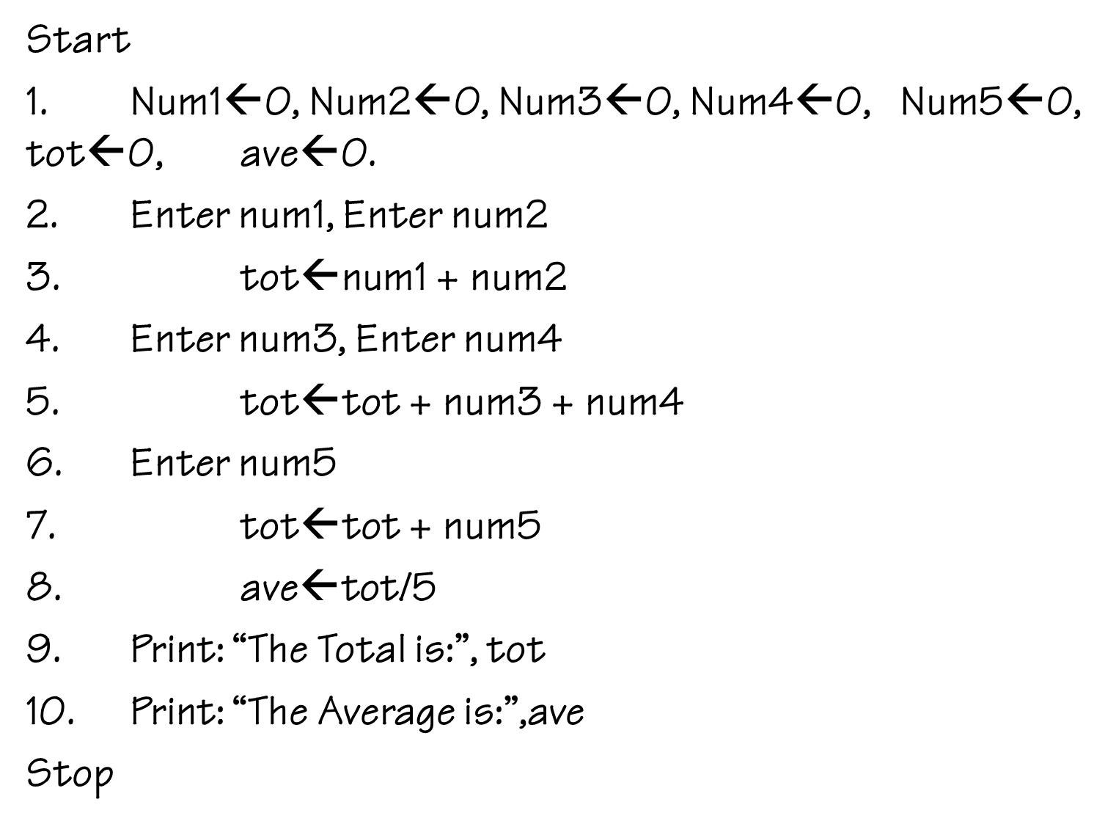
Test it - The trace table
Step | N1 | N2 | N3 | N4 | N5 | tot | Ave | Output

Slide 7
Conclusion
Always initialize
Get your variables first
Note your indentation
Notes:
Conclusion to course, lecture, et al.

