Slide 1
ARRAYS

Slide 2
Consecutive set of memory locations

Slide 3
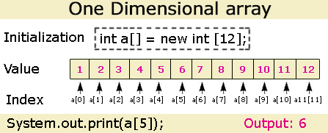
By using assignment statement
Data type array_name[]= { };

Slide 5
DIMENSIONAL ARRAY
A dimensional array is a structure created in memory to represent a number

Slide 6
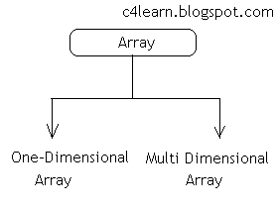
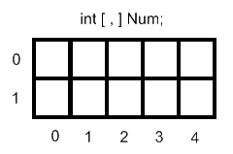
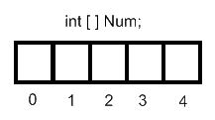

Slide 7
Single Dimensional : Array having only one subscript variable is called One-Dimensional array
It is also called as Single Dimensional Array or Linear array

Slide 8
Multi Dimensional Array having more than one subscript variable is called Multi-Dimensional array
It is also called as Matrix.

Slide 9
Declaring an array
Array can be declared in three ways
By using assignment statement
int a[5]={10,20,30,40,50};
int m[]={1,2,3,4,5,6,7,8,9,10};
char c[]={‘c’,’o’,’m’,’p’,’u’,’t’,’e’,’r’};
String s[]={“Sonu”,”Ram”,”Ajay”};

Slide 10
By using function argument ( Bluej system)
void main(int a[])
void main(char a[])
void main(String a[])

Slide 11
By using input stream
int m[] = new int[10];
m[i]=integer.parseInt(in.readLine());
String s[] = new string[10];
S[i]=in.readLine();

Slide 12
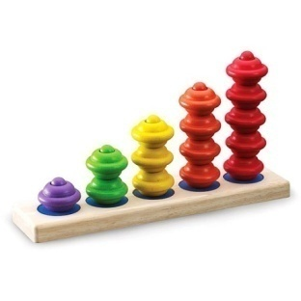
OPERATIONS
USING ARRAYS

Slide 13
SEARCH
This is one of the basic operations
It is a process to determine whether a given item is present in the array or not
There are two ways
SEARCH
LINEAR
BINARY

Slide 14
LINEAR SEARCH
Search begins at the start
Continues one after the other
Each element is checked and compared with the array element until it reaches the data item

Slide 15
Enter the array elements one by one
21
36
55
6
87
19
39
45
6
12
Enter the number to be searched
87
The element is found

Slide 16
import java.io.*;
class linearsearch {
public static void main(String args[]) throws IOException
{
int i,sh,k=0;
int[] m = new int[10];
DataInputStream in = new DataInputStream(System.in);
for (i = 0; i <10; i++)
{
System.out.print("Enter the numbers one by one: ");
m[i]=Integer.parseInt(in.readLine());
}
System.out.print("Enter the number to be searched : ");
sh = Integer.parseInt(in.readLine());
for (i = 0; i < 10; i++)
{
if (m[i] == sh)
k=1;
}
if(k==1)
System.out.println("The number is found " );
else
System.out.println("The number is not found");
}
}

Slide 17
BINARY SEARCH
Takes place only on sorted data items
Array is divided into two halves
The data item is searched either in the first or in the second half

Slide 18
45
57
69
70
72
79
82
84
91
95
First
P
Last
P = (First + Last)/2
= (1+10)/2
=11/2
=5
Number to be searched
84

Slide 19
=
45
57
69
70
72
79
82
84
91
95
>
<
First
P
Last
84

Slide 20
79
82
84
91
95
84

Slide 21
84
<
72
79
82
84
91
95
84
72
45
57
69
70
>
84
=
72

Slide 22
import java.io.*;
public class binary
{
public static void main(String a[])throws IOException
{
DataInputStream in=new DataInputStream(System.in);
int i,ns,p,k;
k=0;
int m[]=new int[10];
int lb=0;
int ub=9;
for(i=0;i<10;i++)

Slide 23
{
System.out.println("enter the elements of the array in ascending order");
m[i]=Integer.parseInt(in.readLine());
}
System.out.println("enter the number to be searched");
ns=Integer.parseInt(in.readLine());
while(lb<=ub)
{ p=(lb+ub)/2;
if(m[p]<ns)
lb=p+1;
else if(m[p]>ns)
ub=p-1;
else if (m[p]==ns)
{
k=1;
break;
}
}
if(k==1)
System.out.println("found");
else
System.out.println("notfound");
}
}

Slide 24
Sorting
Arranging the data either in ascending or descending order
SORT
SELECTION
SORT
BUBBLE
SORT

Slide 25
SELECTION SORT
USED TO SORT THE DATA ITEMS IN A SPECIFIED ORDER
Successive round are executed to select the elements in some order and place them in positions
First the smallest number is selected and swaped with the first element and the next smallest and it goes on

Slide 26
12
4
23
8
36
4
12
23
8
36
4
8
23
12
36
4
8
12
23
36

Slide 27
class selec
{
void x(int a[])
{
int i,j,min,t;
for(i=0;i<9;i++)
{
min=i;
for(j=i+1;j<10;j++)
{
if(a[j]<a[min])
min=j;
}
t=a[i];
a[i]=a[min];
a[min]=t;
}
System.out.println("Array in ascending order");
for(i=0;i<10;i++)
System.out.println(a[i]);
}
}

Slide 28
BUBBLE SORT
Array is sequentially scanned several times
Pair of consecutive elements are compared and interchanged

Slide 29
12
4
23
8
36
4
12
23
8
36
4
12
23
8
36
4
12
8
23
36

Slide 30
class bub
{
void x()
{
int i,j,t;
int a[]={2,4,5,7,1,3,6,9,8,10};
for(i=0;i<9;i++)
{
for(j=0;j<=9-1;j++)
{
if(a[j] <a[j+1]){
t=a[j];
a[j]=a[j+1];
a[j+1]=t;
} }}
for(i=0;i<10;i++)
{
System.out.println(a[i]);
} }
}

